Slide 1
Nystagmus and Strabismus Tracking
John Marshall,
James Liu,
Sean McCarthy

Slide 2
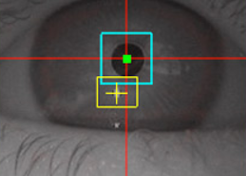
Project Summary
Our project involves creating a pair of glasses that track eye movement to monitor irregular ocular conditions like nystagmus (repetitive, uncontrollable movement) or strabismus (uncoordinated movement of the eye).
This device and accompanying software will be able to provide a user with information about irregular ocular behavior, which can help people with specific conditions monitor their wellbeing.

Slide 3
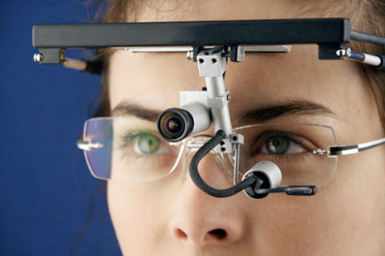
Specific Aims
Complete both a working pair of infrared eye tracking glasses and a software package that receives and analyzes ocular behavior from the glasses
Alert the user of the presence of the aforementioned symptoms
Outfit a pair of small webcams with infrared filters, read in the video from the camera to a computer
Determine whether there is nystagmus or strabismus occurring
Possibly (depending on time) analyze whether this is occurring with greater frequency than normal for the user
Write a basic UI that outputs this information to the user

Slide 4
Background
Problem
Eye tracking is becoming increasingly popular and is finding new applications constantly
Tobii eye tracking for diagnostics
Many diseases and conditions, from inner ear inflammation to lazy eye to dystonia, can cause irregular behavior in the eye.
There are no widely available such headsets that are used instead for regular monitoring.
Benefits
It can signal other long-term issues like cataracts or astigmatism
In a developing child, can be used for early detection of improper ocular development.
Tracking glasses that will analyze movements
This can give insight into the efficacy of medication, the worsening or improvement of a condition, etc.

Slide 5
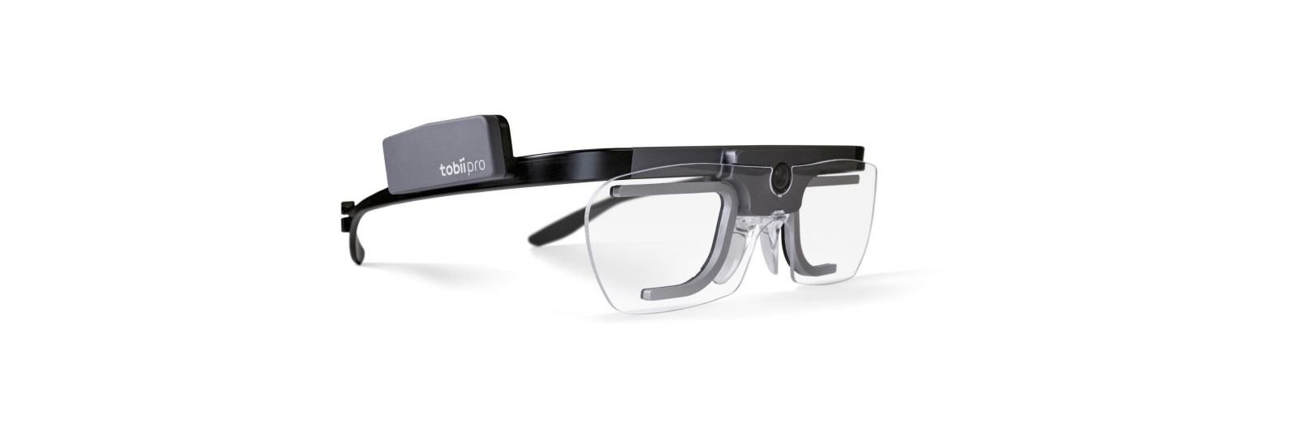
Preliminary Design
Hardware
Three main devices: an infrared camera, a set of photodiodes, and a headset
Camera - most critical part of the physical apparatus because it must accurately and precisely capture the infrared light reflected from the eye and additionally transmit this data to a device
Photodiodes - one or more diodes per eye that distribute infrared rays throughout the retina
Headset - a pair of non-prescription glasses
Software
Pupil Labs open source software package available on GitHub
Python
Program will be written to interpret the data as it is collected by our device and detect a small palette of underlying patterns
Long-term analytics may also be developed to track overall changes in these behaviors over time

Slide 6
Team
James Liu
John Marshall
Sean McCarthy

Slide 7
Milestone Schedule
September 18-October 1: Decide whether to use conventional webcam setup or Raspberry Pi and finalize parts selection. Order parts, hopefully to be received within the week. Begin working on program in Python and studying the Pupil code
October 2-15: Assemble the headset, order any additional parts if necessary. Ensure that the infrared filter works
October 10-15: Write program to read in data from camera (or adapt the Pupil software for this purpose). Continue building the headset as necessary
October 16-29: Split work between data reading and algorithm for identifying strabismus. If the strabismus program is completed, write nystagmus program
(October 16-November 5: Write video/data reading program, leaving time for possible difficulties)
October 30-November 5: Complete nystagmus and strabismus programs and integrate them with the data reading program. Trial run the prototype (nystagmus can be simulated by manually moving eyes, strabismus by using separate video captures for each eye, one when the eye is not moving and one when it is, simultaneously)
November 6-November 19: Refine software for trials, continue testing
November 20-26: If on schedule, break. If behind schedule, do any catching up
November 27-December 3: Write basic application and UI for displaying the results. Make any cosmetic changes to the hardware that seem necessary
December 3-December 17: Prepare reports, finalize design

Slide 8
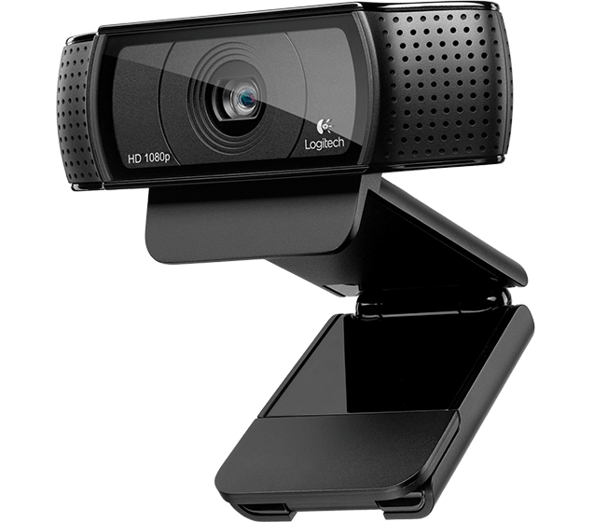
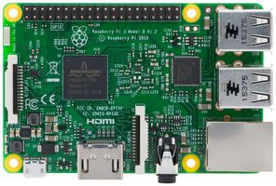
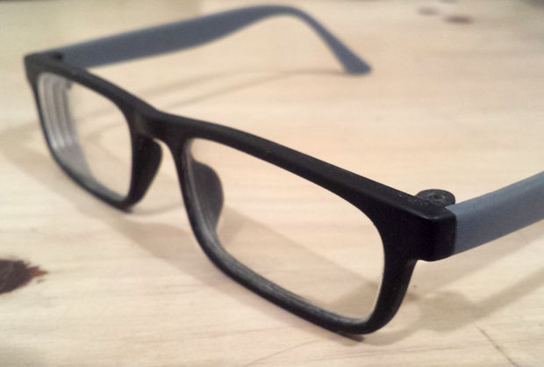
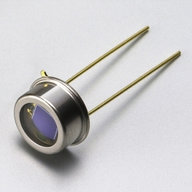
Materials
USB webcam, likely either Logitech or Microsoft LifeCam (x2), price: $40-$100
Infrared camera filter, likely Hoya (x2), price: $80 (already provided with some Microsoft LifeCams)
The above two could be replaced with a Raspberry Pi board with an infrared camera, for example a Raspberry Pi Zero W, $10-$25, plus two Raspberry Pi NoIR Camera Board v2, $30 each, $70-$95 total
LED or photodiode if necessary (to be determined)
Glasses frame, price: $10-30 or other band to fasten camera to forehead (could be 3D printed)
Pupil software available on GitHub (no cost)

Slide 9
Challenges
Expected Problems
Very experimental
Camera hardware issues may include blurriness or diminished quality of captures
Raw output of the camera might be initially difficult to work with if its formatting is unfamiliar
These will be overcome by:
Staying grounded on our goal
Doing adequate research prior to selecting devices
Software will be split into two separate parts: analytics/algorithm and input reading
Using Pupil and PyGaze documentation resources

Slide 10
Citations
“Eye tracking bounding boxes.” http://www.positivescience.com/software/images/eye.jpg
“Pupil Labs.” GitHub. https://github.com/pupil-labs
“OpenGazer.” GitHub. https://github.com/tiendan/OpenGazer
“PyGaze.” E.S. Dalmaijer. http://www.pygaze.org

